Slide 1
Lecture Five
Cyber War in Space &
The Militarization of Space

Slide 2
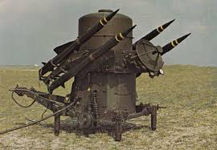
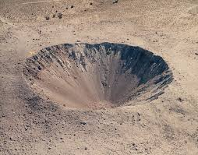
The Cyber Warfare Problem
Suitability

Slide 3
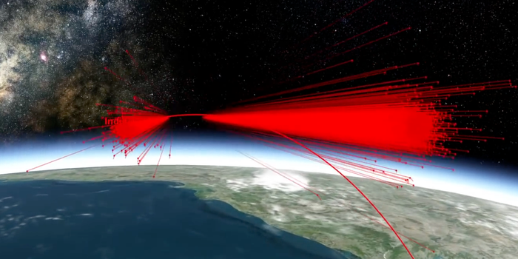
Kinetic Anti-Satellite Weapons
Mission Shakti, Indian anti-satellite test
1600 lb. satellite turned into 6500+ pieces of shrapnel going 22,000 MPH+
Debris field 175 miles above earth
A simulation of space debris created by India's "Mission Shakti" anti-satellite missile test on March 27, 2019. Analytical Graphics Inc.

Slide 4
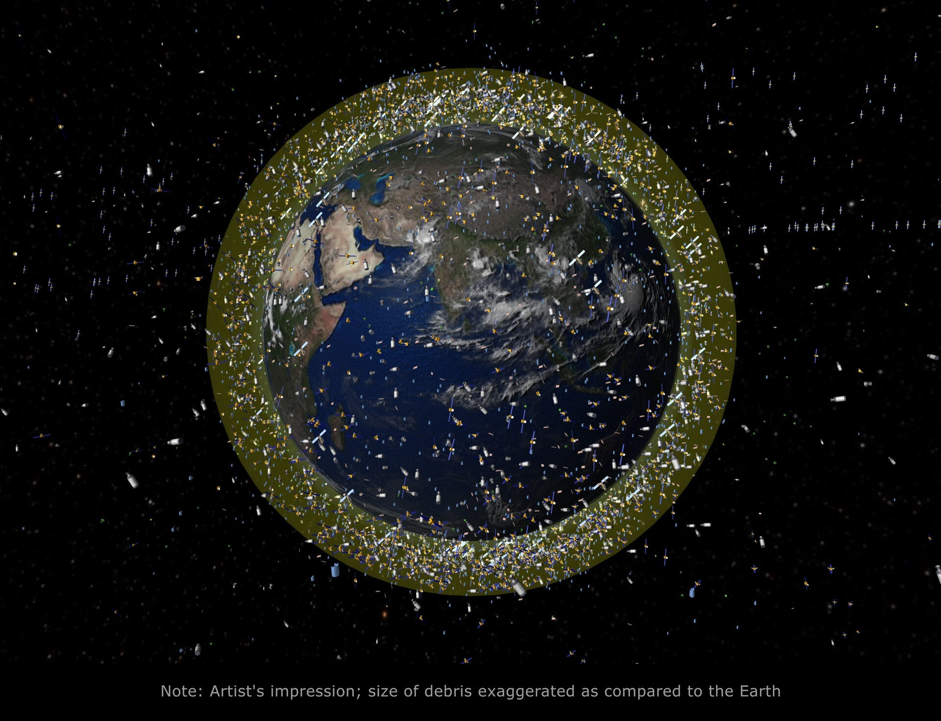
Kessler Effect
One event could cascade into more, polluting entire orbital areas
SpaceX alone at 5,000+ already
Launches accelerating
More space objects = worse curve for Kessler Effect

Slide 5

Understanding Cyber Warfare
Notes:
What is an exploit – the delivery mechanism
What is an implant – the warhead
The bottom bullet –Attack, is the only time we are carrying out a covert action or act of war.

Slide 6
Cyber War Operational Phases
Targeting
Access
Action

Slide 7
Targeting
Reason for targeting
Tactical response
Strategic response
Is there a known cyber target that supports that reason
Appropriate Targeting
Cyber is the best (or only) option
The desired cyber effect exists
The desired effect can be developed in a timeline that supports the tactical or strategic goal
There is a realistic potential for access of the enemy target and delivery of the cyber-attack-effect
Notes:
The cyber attacks hackers could deploy to degrade disable or destroy a satellite system

Slide 8

Target Selection
Targeted based on opportunity
Known ability to access (vulnerability, supply chain interdiction, insider threat, etc.)
Targeted based on who owns SV
Operated by a government or company the attacker wants to impact
Targeted specifically
Space System targeted because of exactly what it is
Targeted based on what SV does
Going after any space system with a certain mission or missions
Notes:
The cyber attacks hackers could deploy to degrade disable or destroy a satellite system

Slide 9
Cyber Actions
Exploit
Gain access to a target
Gain context on a target
Implant
Maintain / expand access
Install Operational Capability
Operate
Collect
Attack

Slide 10
Attribution Phases
Discovery
Association
Actor Identification
Motive Identification
Act of War
Everything else
We care because this dictates tradecraft

Slide 11
Access
Type Needed
None
Non-interactive
Interactive
Gaining Access
May require heavy redirection
Target and redirector exploitability can change hour by hour
Target availability and susceptibility can change hour by hour

Slide 12
Action
Access issues may dictate non-interactive instead of interactive
Battle damage assessment (BDA) is essentially impossible
May have to openly take responsibility to facilitate show of force

Slide 13
Self-Attribution Considerations
Unintentional
Intentional (false flag)
Projection of force

Slide 14
Resources
Resource Types
Backend
Obfuscation
Things that gain access (exploits)
Things that keep access (implants)
Things that are done via access (collection / attacks)
Resource Considerations
Resilience
Control
Ownership

Slide 15
Is Cyber War as Problematic as Biological War?
Obviously not from an optically heinous perspective but…..
Impact to civilians
Difficult BDA
May not affect target,
May affect others
Tactical issues (returning fire)
Strategic issues (can’t plan around it)

Slide 16
Resource Considerations Cyber War in Space
Resource Considerations
Resilience – less likely to get patched out?
Control – safer when throwing?
Ownership – hard to do forensics and pull back for RE?
BDA is still a challenge

Slide 17
Space Based Kinetics
Space-based anti-satellite nuke?
Russia, recently for anti-space (EMP)
Limited by horizon at time of detonation
Realistic threat or saber rattling?
Probably makes more sense to just have terrestrial based?
Space-based Conventional warheads
Star Wars
Orbital mechanics make space-based weaponization more showing of than realistic threat?
Don’t forget Kessler; if you go down this road you are basically saying you are ok without access to space yourself

Slide 18

The Impacts of a Space Force
Has creation of Space Force exacerbated? (kind of already existed under USAF)

Slide 19
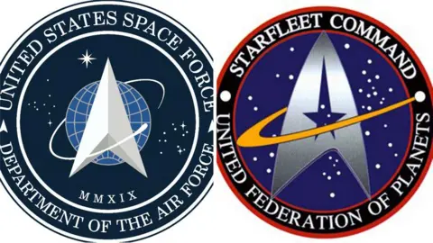
That logo seems familiar….
According to reliable internet sources, Star Trek based their 1966 logo on the 1961 Air Force Space Command logo.

Slide 20
Compare and Contrast Space and Cyber Domains
Great for information gathering
Spy satellites
Commercial satellites
Malware collection platforms
Ad information buying and selling
Not great for strategically sensical or tactically impactful warfare
No real expectation of protection
Attribution has major differences, thanks to physics coming into play
Cue the EW segway

Slide 21
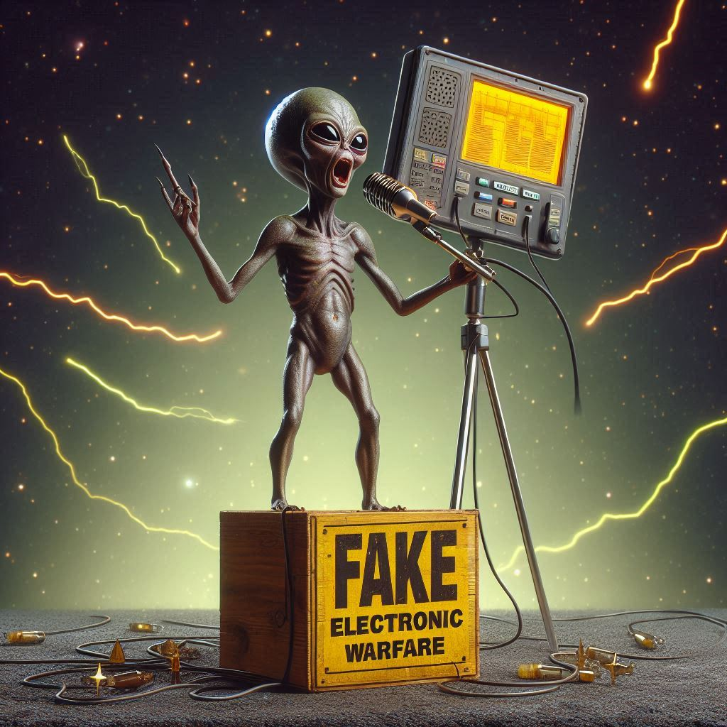
Electronic Warfare
Jamming
Spoofing
Importance of separating from cyber threats
Is this cyber? Is this a cybersecurity problem?
Why is it problematic to too closely associate the two
From a defensive perspective
From an offensive perspective

Slide 22
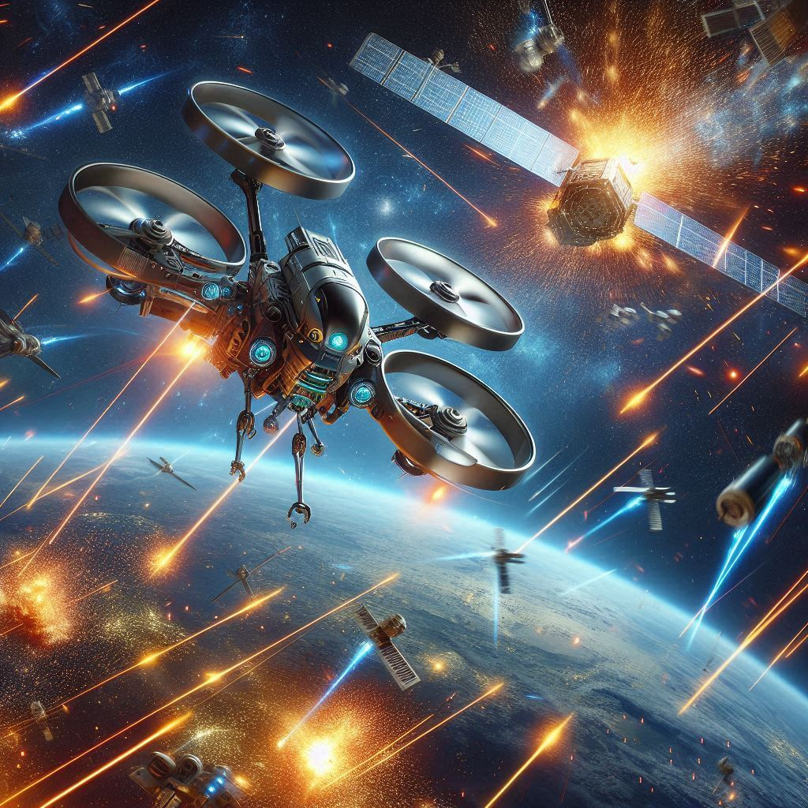
Cyber Against Drones vs Satellites
ROI
Resource resilience etc
Killing one of a million drones or 1 of 10 satellites

Slide 23
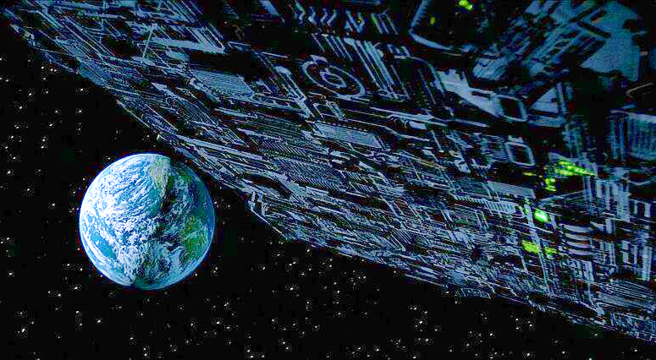
Territorial Space?
When we face extraterrestrial threat?

